Slide 1
Welcome to Kindergarten Round-Up at Bathgate Elementary 2024-2025
Capistrano Unified School District
Bathgate Elementary School
Notes:
‹#›

Slide 2
Welcome Future Bathgate Blazers!
Your incoming Kindergarten children are members of the high school graduating class of
2037

Slide 3
Agenda
Welcome/Introductions
Kinder Readiness
Overview of Kinder Program
Registration Process
CUSD District Nurse – Ms. Kellman
Bathgate’s PTA - Tanya Berard
YMCA - Jessica Cervantes
Food and Nutrition

Slide 4
About Bathgate Elementary
Enrollment – 577 students with 24 fully credentialed teachers in TK – 5
Fee-based Pre-School
Part-time Assistant Principal, Counselor, PE Teacher, Music Teacher
PBIS (Positive Behavior Interventions and Supports) schoolwide

Slide 5
About Bathgate Elementary
1:1 Chromebooks for all students
At least 8 i-Pads in every kindergarten class
Part time LVN and part-time library tech
After school YMCA program and Kid’s Factory
Saddleback College After School Classes

Slide 6
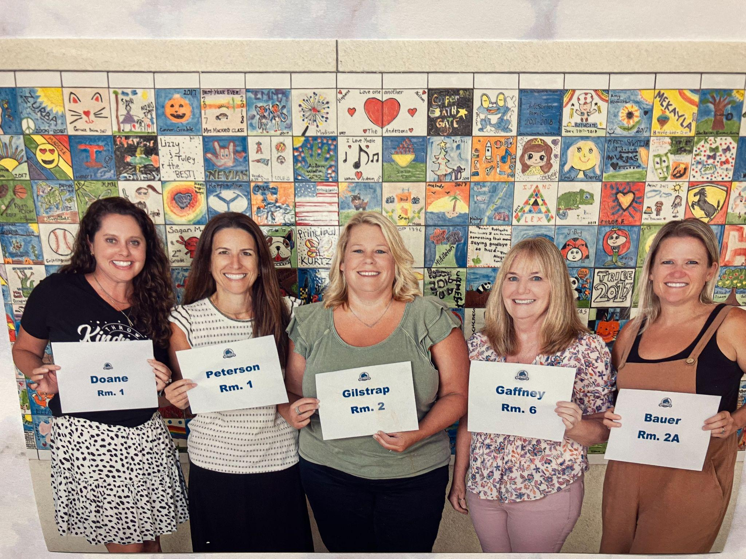
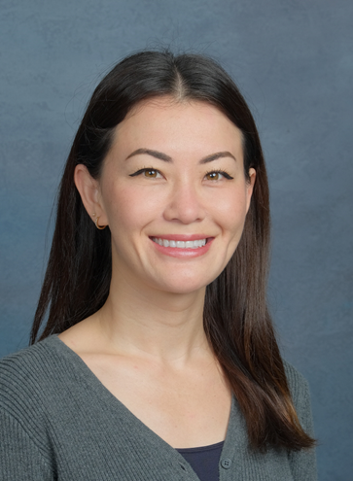
Meet our AMAZING Kindergarten Teachers!
Michele Doane/Christy Peterson
Tiffany Gilstrap
Lanett Gaffney
Kim Bauer - TK
Minh Nguyen

Slide 7
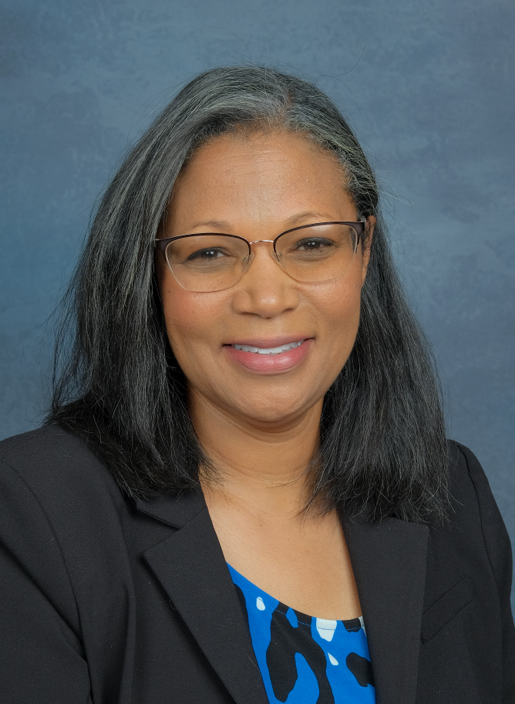
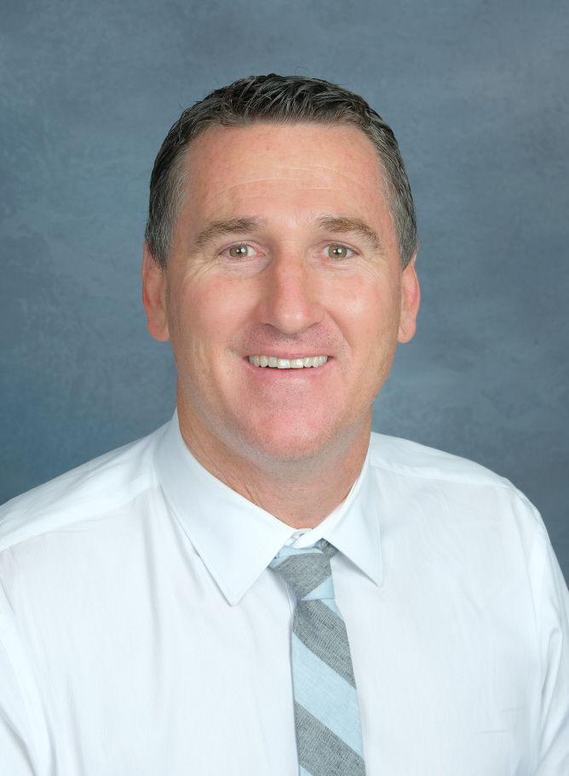
New People in Your Child’s Life will Include:
Natalie Odebunmi, Principal,
njwestodebunmi@capousd.org
Pete Butler, Assistant Principal,
Pjbutler@capousd.org

Slide 8
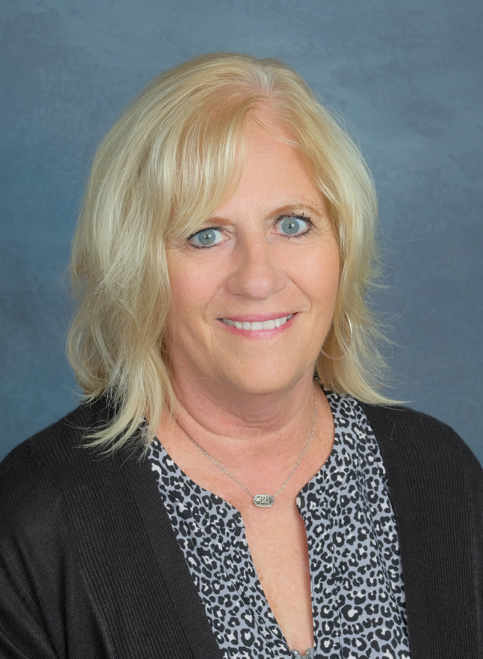
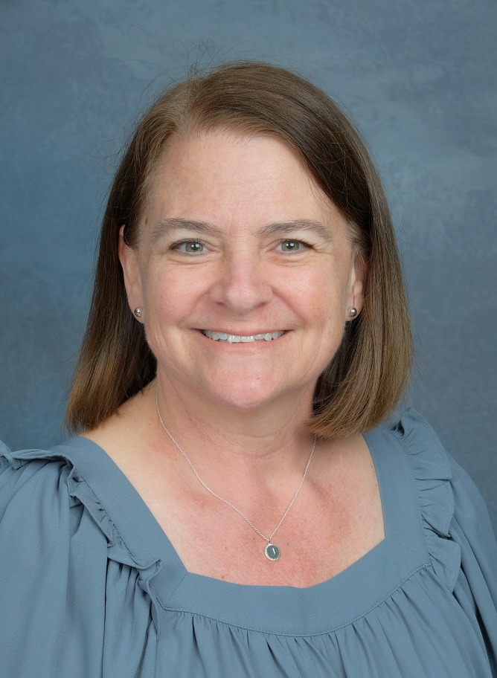
Meet Our Amazing Office Staff...
Jane Egertson, Office Manager,
jwegertson@capousd.org
Jenny Clark, School Clerk,
jhclark@capousd.org

Slide 9
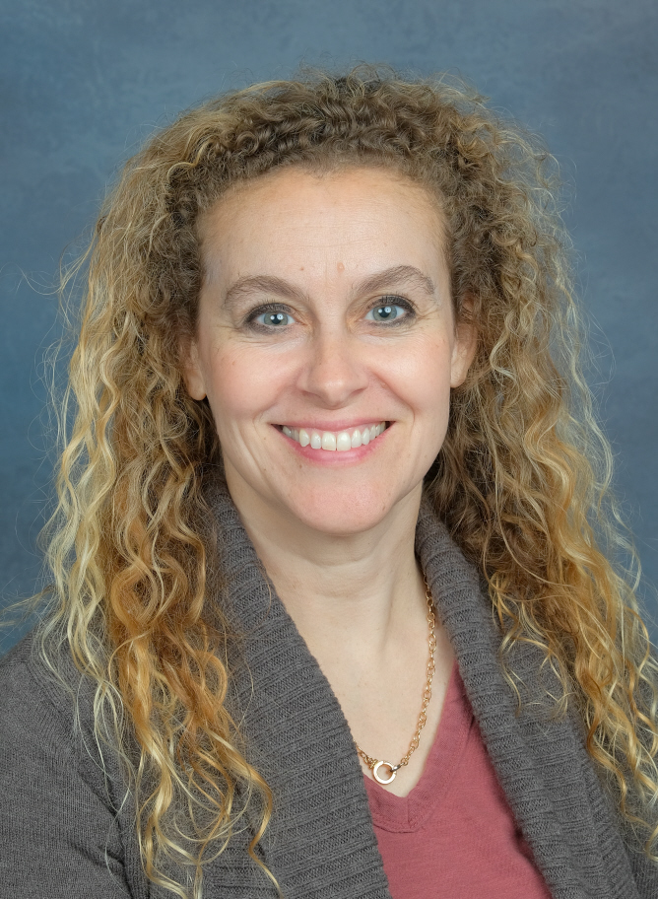
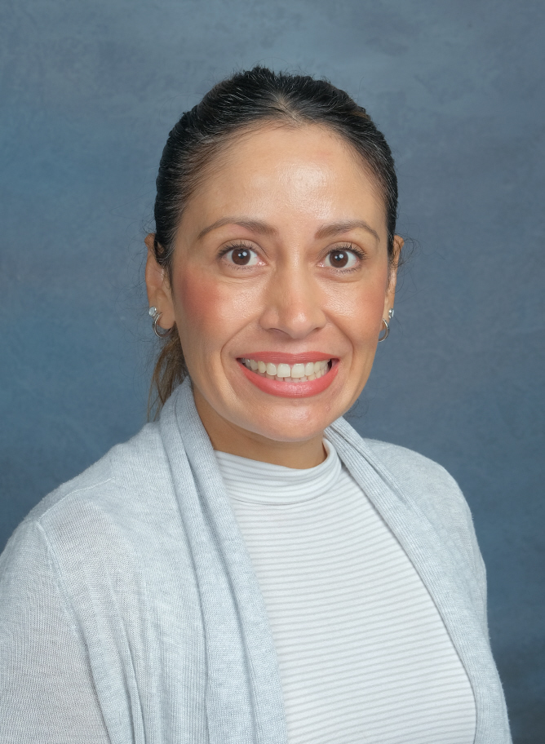
LVN
Sunshine Emerick SUEMERICK@capousd.org
Bilingual Community Liaison
Sandra Ventura, saventurahernandez@capousd.org

Slide 10
Is My Child Ready
for
Kindergarten?

Slide 11
Kindergarten Readiness Social and Kinesthetic
A child entering kindergarten should be able to:
Express himself/herself verbally
Speak in complete sentences
Ask questions
Have the confidence to separate from a parent or caregiver and stay with another adult

Slide 12
Kindergarten Readiness Social and Kinesthetic
A child entering kindergarten should be able to:
Share with others willingly - Cooperate
Play alone without adult assistance
Finish what he/she starts
Run, hop, jump, swing and gallop
Roll, throw and catch a ball
Clean up after working and playing

Slide 13
Kindergarten Readiness Academic Readiness
Children in Kindergarten need to be able to:
Sit still for 10 to 15 minutes
Work individually and in small groups
Listen to a story or participate in an activity
Respond to questions related to an activity
Follow simple two-step directions
Hold a pencil correctly

Slide 14
Kindergarten Readiness Academic Readiness
Signs of academic readiness include:
Showing an interest in print and books
Uses pencils, crayons, markers, and scissors
Recognizes his/her own name
Beginning to write his/her own name with a capital and lowercase letters

Slide 15
Kindergarten Readiness Academic Readiness
Knows shapes and colors
Counts 10 objects and recognizes numerals 1-10
Recognizes and names uppercase and lowercase letters out of sequence
Knows at least half of the letter sounds
Has limited exposure to electronic media

Slide 16
Bathgate’s Kindergarten Program

Slide 17
Kindergarten or Transitional Kindergarten (TK)?
Children born between Sept. 2, 2019 - April 2, 2020 are eligible for TK. Children will be turning 5 within these dates.
Children turning 5 between June 1st and September 1st 2020 may be eligible for TK if there is space available.
Contact: ecptk@capousd.org
for TK information

Slide 18
Kindergarten Schedule
Every M-T-Th-F
8:00 a.m.-2:10 pm
Every Wednesday
8:00 a.m.-12:55 pm

Slide 19
Kindergarten Schedule
Daily Routine
Flag Ceremony (Fridays only)
Language Arts
Recess
WIN/Chromebooks
Lunch
Math
Science/Social Studies
Recess
PE/Art
Library
Music

Slide 20
The First Day of School!
Tuesday, August 20th
8:30am-9:43am
*Kindergarteners will attend a shortened first day of school without parents.
Save the Date:
Kindergarten Assessments
Wednesday, August 14th
Last Name - A-L 9:00 - 10:30
Last Name - M-Z: 10:30 - 12:00

Slide 21
Snack/Lunch Food
Kindergarten is “nut safe” - not “nut free”
Snack
Small nutritious snack to eat in 10 minutes
Lunch: 20 minutes to eat, 20 minutes to play
Please have your child practice opening and closing lunch boxes and baggies. School does not provide utensils.

Slide 22
Drop-off/Pick-up
Parents will stay behind the front blue gate during drop off and pick up.
Drop-off
Drop-off starts at 7:45 am
Students come to the kindergarten yard
Sit in line with their backpacks
Pick-up
Pick-up at 2:10 pm
Dismissal in front of blue gate to an adult
YMCA and Kids Factory will escort kinder students

Slide 23
School Supplies
Kinder “School Tool Box”
You can order a school tool box for $ 61.68
Order between February 28th - June 9th (https://schooltoolbox.com, navigate to Find Your School, put in Bathgate)
Everything you need for school supplies and the preferred brand!
Supplies will be in child’s classroom on the 1st day of school.
School supply list also on the Bathgate website if you’d like to shop the sales!

Slide 24
Visiting/Volunteering
at Bathgate
Visitors/Volunteers:
MUST sign in and out of front office and wear a badge
Tier I –unsupervised contact
Tier II – supervised contact

Slide 25
We Love Our Volunteers!
Only Tier 1 volunteers can attend field trips!
Secure Live Scan will be at Bathgate in August and/or September to fingerprint all Tier 1 volunteer applicants.
More information to come via School Messenger

Slide 26
How Do I Enroll My Child To Bathgate’s Kindergarten Program?

Slide 27
Enrolling at Bathgate?
Bathgate is open to students residing in Bathgate or Viejo boundaries.
School of Choice applications are available on the CUSD website. In order to apply, the student must first register at their home school to obtain their 7 digit ID number.
Bus transportation from Viejo is available.

Slide 28
Registering for Kindergarten
Registration instructions and forms can be found on the Bathgate Website
Registration is a two-step process!
Online registration with CUSD is now open-
go to https://Bathgate.capousd.org. Click on the “Registration” tab.
Return completed registration packet to
Bathgate starting on February 29, 2024 between 9:00 am – 1:00 pm along with:
Online registration print-out
- Required documents

Slide 29
Required Documents for School Enrollment
Birth Certificate (County/State Copy) Student MUST be five years old by September 1, 2024
Proof of Residency (Current utility bill AND rental agreement/escrow documents)
Immunization Record
(CA Yellow Card or other State record)
YMCA Enrollment Confirmation
(if applicable)
Parent Identification

Slide 30
Registering for Kindergarten
IF YOUR CHILD IS CURRENTLY IN TRANSITIONAL KINDERGARTEN IN CUSD:
You do NOT need to register online.
Bring current residency papers consisting of mortgage/rental agreement and a current utility bill to Bathgate starting on February 29, 2024 from 9:00 am – 1:00 pm.

Slide 31
Registration Packet Special Needs
Current IEP?
Speech and/or Language concerns?
Social/Emotional concerns?
Please specify on Program Information form in registration
packet.

Slide 32
STARS
Success Through Academic Readiness and Social Skills
The STARS Program
smaller classroom setting
slower pacing,
small group instruction
specialized strategies are implemented
The program addresses student needs related to academics, language, behavior, and social skills.

Slide 33
STARS
Success Through Academic Readiness and Social Skills
Placement is determined by the Individualized Education Plan (IEP) team.
Student participation in general education is determined individually based on each student’s unique needs, as determined through the IEP process.
Related service providers are incorporated as needed and determined by the IEP Team to further support each student’s individual needs.

Slide 34
Let us know if your plans change!
If you’re “kindergarten shopping”
If you change your mind on attending
If you move away
If you decide to wait one more year for kindergarten…
Please help us plan for next year by letting us know as soon as possible

Slide 35
CUSD Food & Nutrition Services
Servicios de Alimentación y Nutrición del CUSD
Breakfast and lunch are available to ALL students at CUSD for FREE.
El desayuno y el almuerzo están disponibles GRATIS para TODOS los estudiantes de CUSD.
Meals follow regulations from the Healthy Hunger Free Kids Act and include whole grains, protein, fruits, veggies, and milk.
Las comidas siguen las regulaciones de la Ley de
Niños Saludables y Sin Hambre e incluyen cereales
integrales, proteínas, frutas, verduras y leche.
CUSD is the first district in southern California to
receive a certification with Eat Real.
CUSD es el primer distrito del sur de California
en recibir una certificación Eat Real.

Slide 36
Education Benefit Form
Formulario de Beneficios Educativos
Submit an Education Benefit Form to see if your family qualifies for benefits.
Envíe un formulario de beneficios educativos para ver si su familia califica para recibir beneficios.
Submit yearly starting in August.
Enviar anualmente a partir de agosto.
Questions? ¿Preguntas? 949-234-9509.

Slide 37
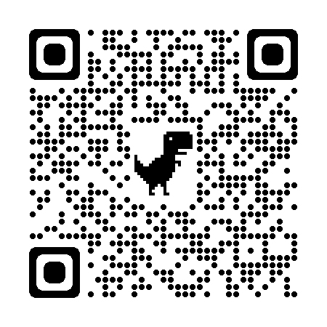
FAQ / Preguntas Frecuentes
My student has a food allergy - what do I do? Mi estudiante tiene alergia alimentaria: ¿qué hago?
Submit a Medical Statement to Request Special Meals. Must be signed by physician, physician assistant or nurse practitioner. Available at capistrano.healtheliving.net
Presentar una Declaración Médica para Solicitar Comidas Especiales. Debe estar firmado por un médico, asistente médico o enfermera especializada. Disponible en capistrano.healtheliving.net
We are a vegetarian family - what do I do? Somos una familia vegetariana, ¿qué hago?
Vegetarian options are available daily and are indicated on the menu.
Las opciones vegetarianas están disponibles todos los días y están indicadas en el menú.
Our family does not eat pork - what do I do? Nuestra familia no come cerdo, ¿qué hago?
Few items contain pork and are indicated on the menu.
Pocos artículos contienen carne de cerdo y están indicados en el menú.
Food & Nutrition Services Contact Information:
949-234-9509
Capistrano.healtheliving.net
CapoFood

Slide 38
Health Conditions
Include any diagnosis in parent portal
Keep your contact phone numbers updated
Contact your district nurse:
Ms. Kellman for any questions or concerns or kekellman@capousd.org 949-234-9568

Slide 39
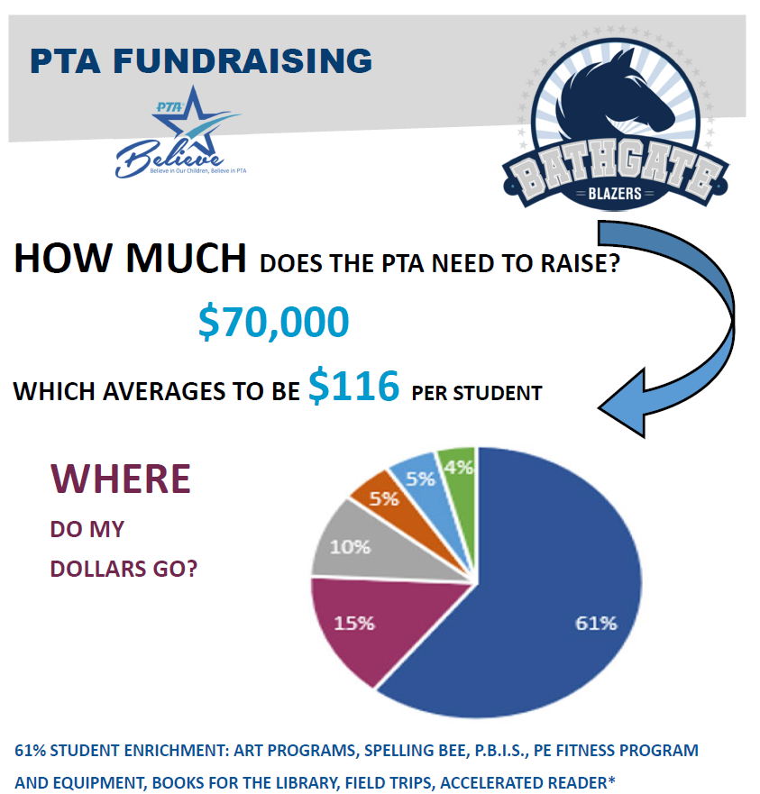

Slide 40
Bathgate’s Partners
PTA President -
Tanya Berard
president@bathgatepta.com
YMCA Director – Jessica Cervantes
jcervantes@ymcaoc.org
949-363-7089

Slide 41
Stay Informed
Bathgate Website https://bathgate.capousd.org
Sign-up for School Messenger TODAY!
Facebook @bathgateblazers
Instagram @bathgateblazers
Twitter @BathgateBlazers
Threads @Bathgateblazers

Slide 42
I believe the children are our future
Teach them well and let them lead the way
Show them all the beauty they possess inside
Give them a sense of pride to make it easier
Let the children's laughter remind us how we used to be
Linda Creed / Michael Masser
Notes:
I found this online from a fellow educator, Dajia Brody, and it perfectly sums up what we believe at Bathgate.
We believe that every child is a unique individual who needs a secure, nurturing and stimulating learning environment. It is our duty as educators to plant the seed of knowledge and help students bloom mentally, physically, emotionally and socially. Whitney Houston’s song, "The Greatest Love of all', is a great song that embodies our educational philosophy.
I believe the children are our future....
The future is indeed in the hands of all the children of the world. All children in some form or fashion will one day affect change in the world. Teachers are responsible for molding presidents, doctors, lawyers, engineers, architects and educators.
Teach them well and let them lead the way......
Teachers have one of the most important jobs in the world, and that is educating future leaders. Thinking critical, questioning and analyzing are three major skills that will allow students to be active agents in their learning.
Show them all the beauty they possess inside. Give them a sense of pride.....
Our roles as educators is not only to teach, but encourage and build confident scholars. We want students to know the importance of self-worth and acceptance.
Let the children's laughter remind us how we used to be
Laughter is contagious. All current Blazers know that I love their Kid Jokes. My goal as an educator is to be the reason your children smile. Maya Angelou said, "People will forget what you said, people will forget what you did, but people will never forget how you made them feel."

Slide 43
Thank you for attending today’s meeting!
Welcome to the
Bathgate Family!!

